Slide 1
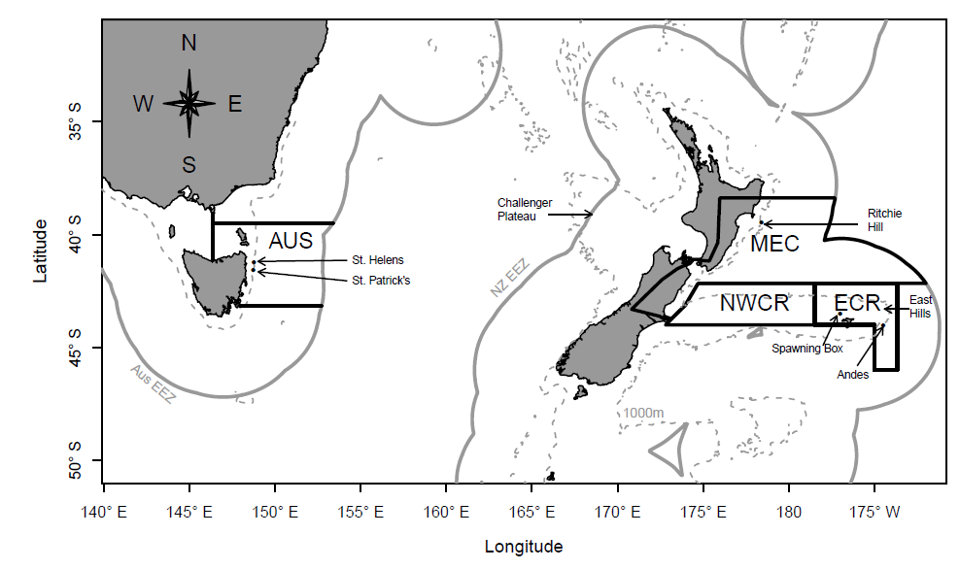
Mapping in R
Allan Hicks
FISH 507H Beautiful Graphics in R
11/28/2012

Slide 2
Maps
A graphic representation of a portion of the earth’s surface, drawn to scale
Purpose
Display information geographically
Locations, distance, terrain, etc.
Give directions from and to locations
Associate data and results geographically
For example: habitat types, collection sites, …

Slide 3
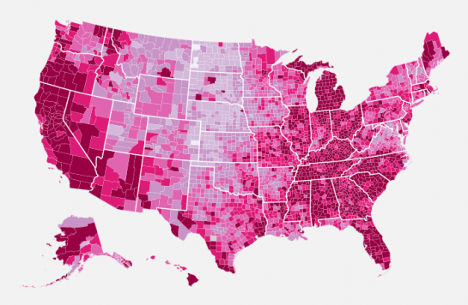
http://blog.revolutionanalytics.com/2009/11/choropleth-map-r-challenge.html

Slide 4
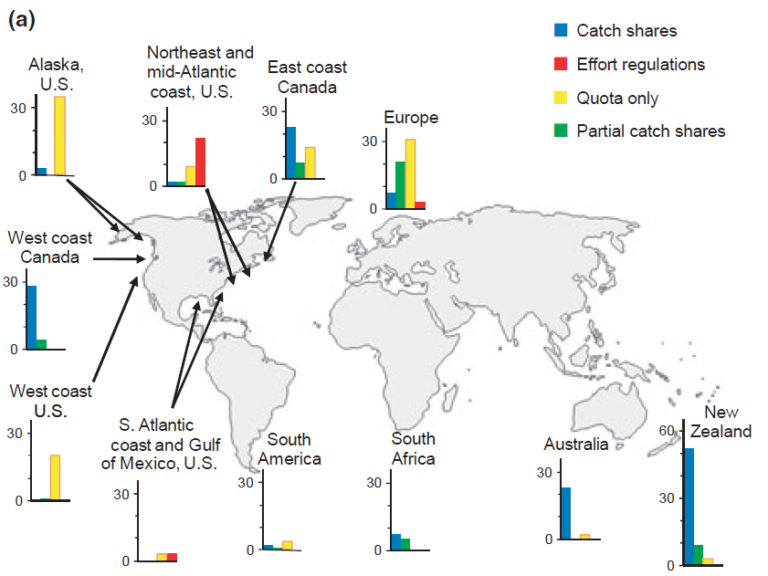
Melnychuk et al 2011, Fish and Fisheries

Slide 5
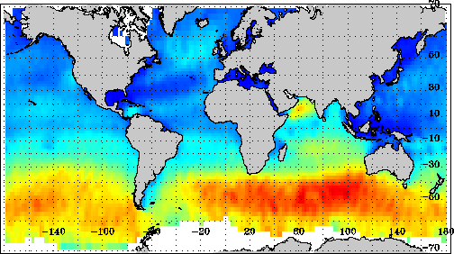
July average wave height

Slide 6
Projections
Mapping the surface of a sphere
Rectangular (default)
with aspect ratio so that lon & lat scales are equivalent at the center of the picture
Mercator
Conformal – preserves angles of course
Distorts the area away from equator
Bonne
Equal area
Many others…

Slide 7
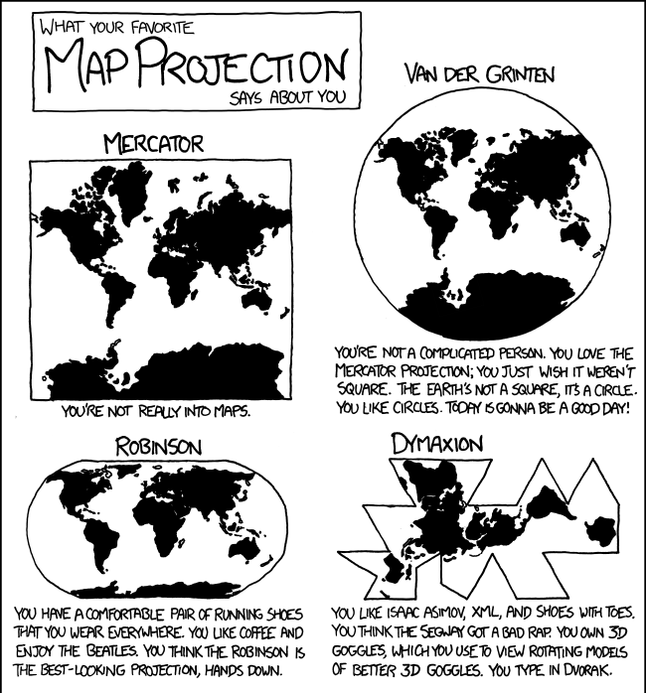
http://xkcd.com/977/

Slide 8
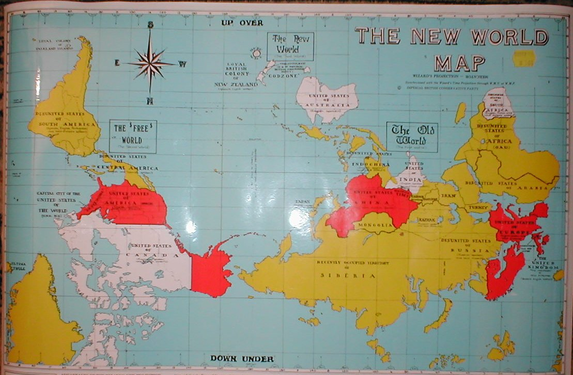
The Wizard’s view
http://flourish.org/upsidedownmap/

Slide 9
Mapping in R
This is not GIS
But can read shapefiles
We want to plot spatial data such that the lat and lon are not distorted too badly
Many different ways to display spatial data
Plot latitude & longitude as x and y
Use the spatial package called sp
The map package and associated tools
The PBSmapping package
Many other methods …
Notes:
We don’t want to plot using plot because it would give a false impression of x and y distances

Slide 10
The map package (and others)
Packages
map, maptools, mapproj, mapdata
Functions
map: the main function
map.axes
Can use points, lines, etc. easily with default projection
Projections
Some functions are meaningless with a projection
Map.scale, map.axes, …
You can use mapproject to convert to projection x,y coordinates

Slide 11
Map Data Structure
Of class “map” with a list containing
x: latitude values with polygons separated by NA
y: longitude values matching x (NA’s also)
range: x and y ranges
names: names of the polygons

Slide 12
Shapefiles
Files containing geographic information
Usually obtained from GIS specialist
Use readShapePoly and other functions from the maptools package
I usually just ask for a shapefile with lon & lat coordinates (not any other special formats)

Slide 13
Other data sources
Can download a lot of data from different sources
Shapefiles (i.e., census)
GSHHS (Global Self-consistent Hierarchical High-resolution Shoreline database)
Internet (http://topex.ucsd.edu/cgi-bin/get_data.cgi)
R packages (mapdata, PBSmapping, mapplots)

Slide 14
PBSmapping
http://www.dfo-mpo.gc.ca/Library/285683.pdf
Powerful mapping package, especially useful for the Northeast Pacific
Has high resolution shoreline data (GSHHS)
Uses a PolySet with
PID: primary ID
SID: Seconday ID
POS: Position number
X: longitude
Y: latitude

Slide 15
Other R packages
rworldmap: Maps of countries with attributes
mapplots: data visualization on maps
geo: N. Atlantic used by HAFRO for fisheries
sp: Spatial data
Imap: Point and click interface
ggmap: plot on top of Google maps
gmt: interface with GMT mapping software
plotGoogleMaps: data on Google maps
RgoogleMaps: Google map backgrounds

